Slide 1

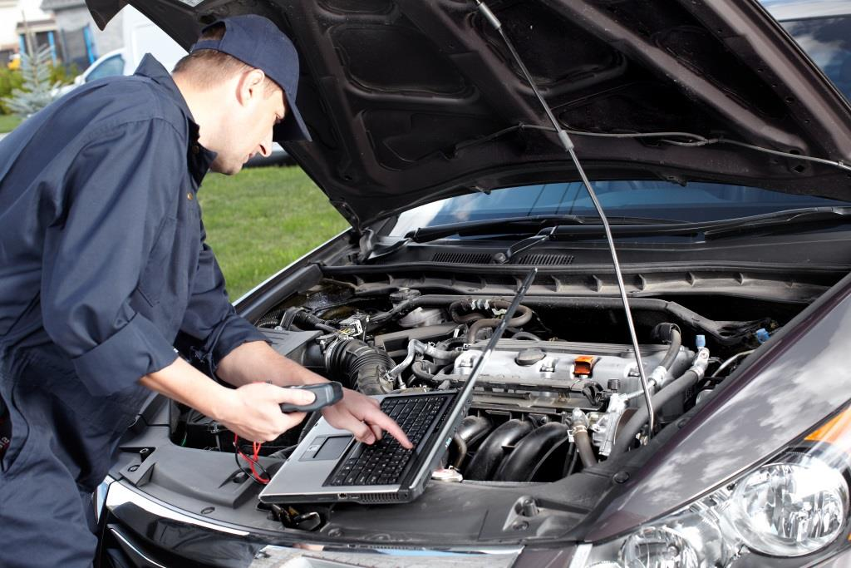
Penn Liberty Motors
Services &
Repairs
Contact Us

Slide 2
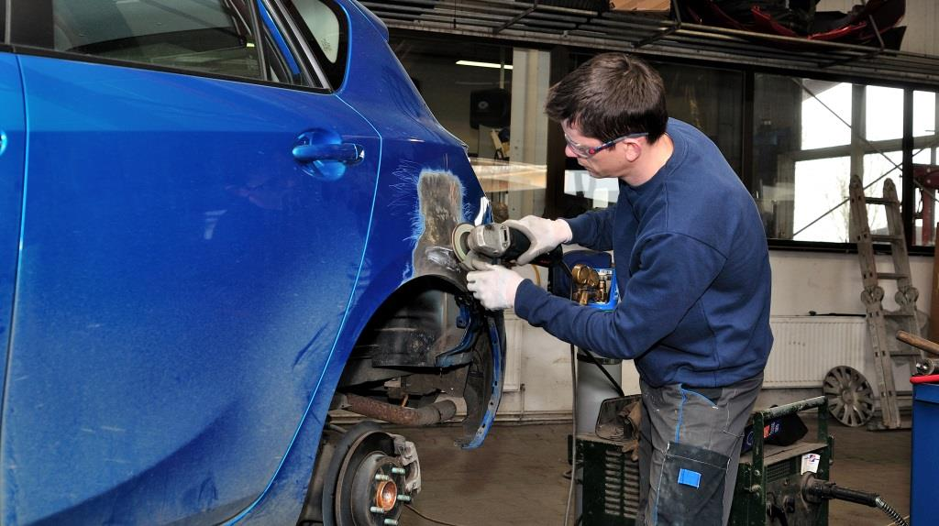
Repairs
Tires
Body Work
Radiator
Ignition
Fuel Injection
Transmission

Slide 3

Maintenance
Tires
Brakes
Oil Change
Fuel System
Inspections
Emission

Slide 4
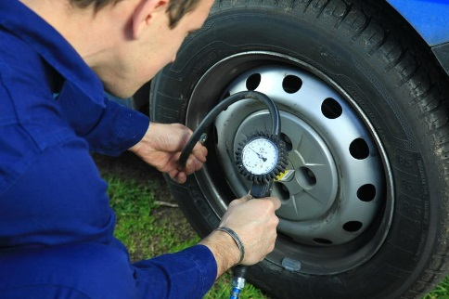
Services
Electrical Control
Steering
Fuel System
Clutch
Air Conditioning

Slide 5

Warranty Services
Electrical
Transmission
Suspension
Exhaust System

Slide 6
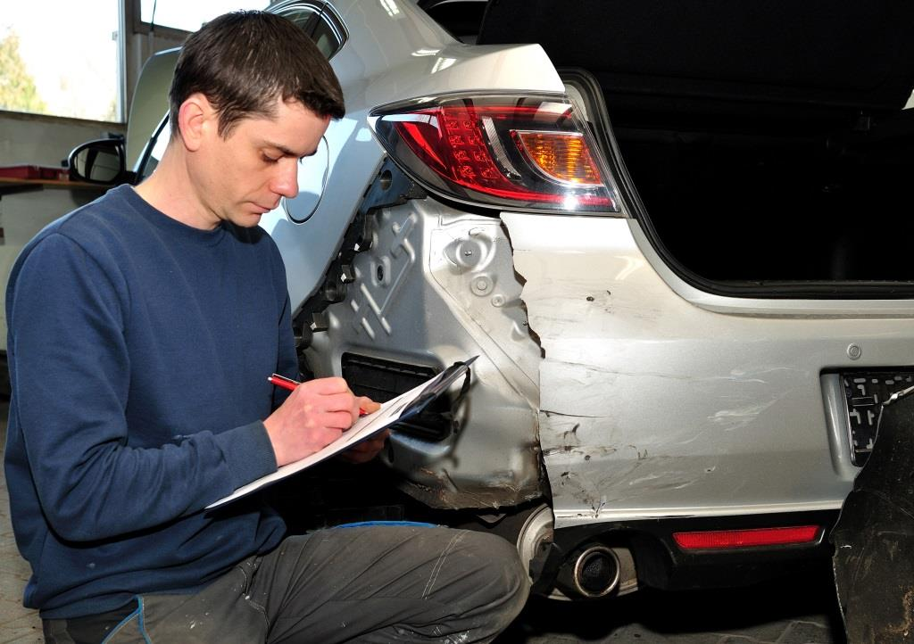
Insurance Claims
Free Estimates
Work With Insurance Carrier
Help With Insurance Forms
Quick Turnaround

Slide 7

Customer Service
Loaner Cars Available
Towing
Roadside Assistance
Quick Response Time
Available on Weekends

